Slide 1
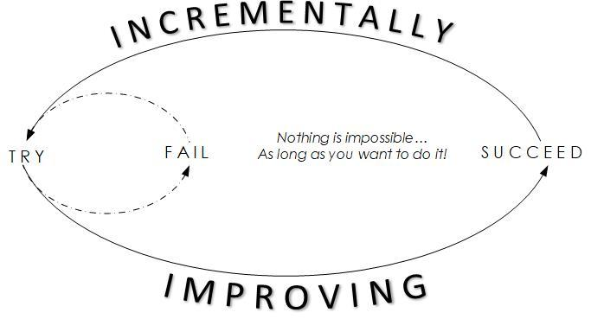
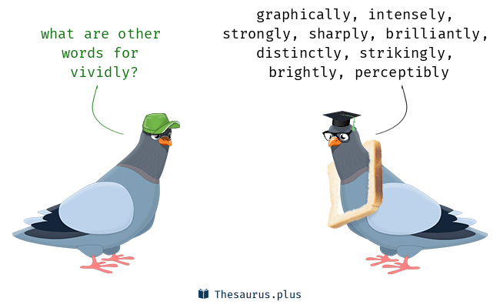
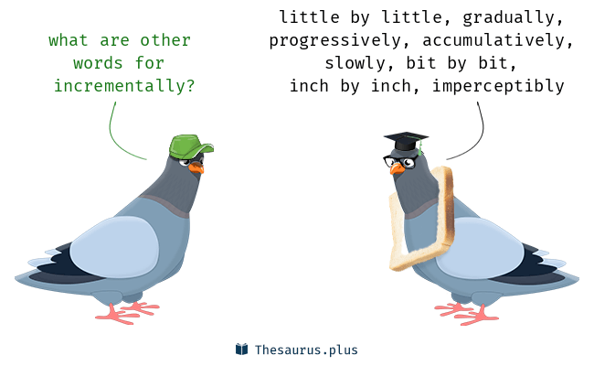
Educational
.
Polyglots
Enjoyment
Effective
Method
Create a system
Plan ahead
Have patience
method
Discussion
Set language-learning goals. The first step to learning a new language fast is to set goals for what you want to achieve. ...
Learn the “right” words. ...
Study smart. ...
Start using the language all day, every day. ...
Seek out real-life practice. ...
Learn about the culture. ...
Test yourself. ...
Have fun!
…
Christopher Bauman – www.chrisbauman.com.au

Slide 2
1. How do you enjoy language learning ____________________________________________________________________________________________?
Advanced Question Words
2. What is something that you plan well now ___________________________________________________________________________________________ ?
Dawned on me
In common
3. What do you need patience for ___________________________________________________________________________________________ ?
Start reading
Unique way
4 How can you learn in small chunks ___________________________________________________________________________________________ ?
5. I want you to vividly remember a moment in time ___________________________________________________________________________________________ ?
Long term view Vs short term view
gibberish
Self talk
15 minutes
6. What is a little victory for you ___________________________________________________________________________________________ ?
Learn one word from the person next to you
7. Share a time that you were resilient and did not give up ___________________________________________________________________________________________ ?
Who or what motivates you
8. Is someone making fun of you a motivator ____________________________________________________________________________________________ ?
.
How can you take your learning into your own hands
Christopher Bauman – www.chrisbauman.com.au

Slide 3



