Slide 1
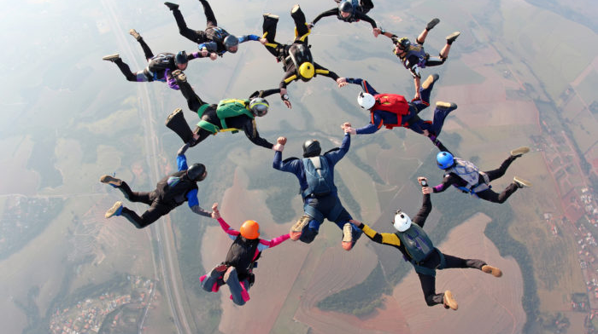
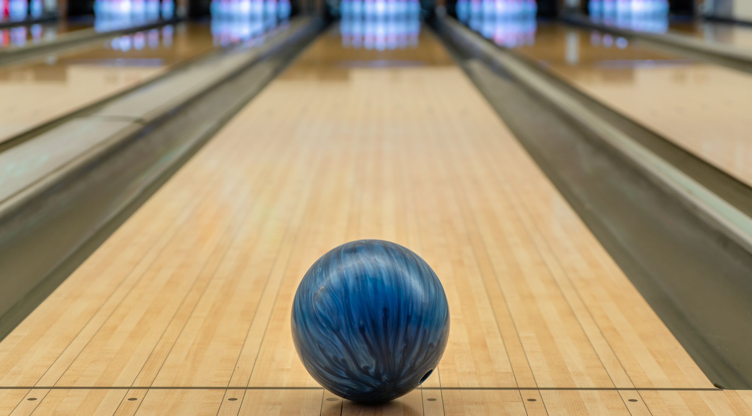
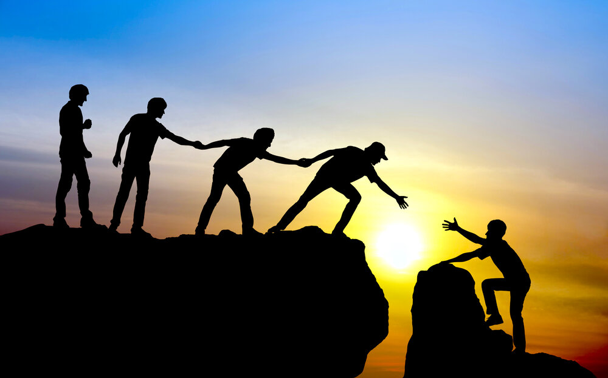
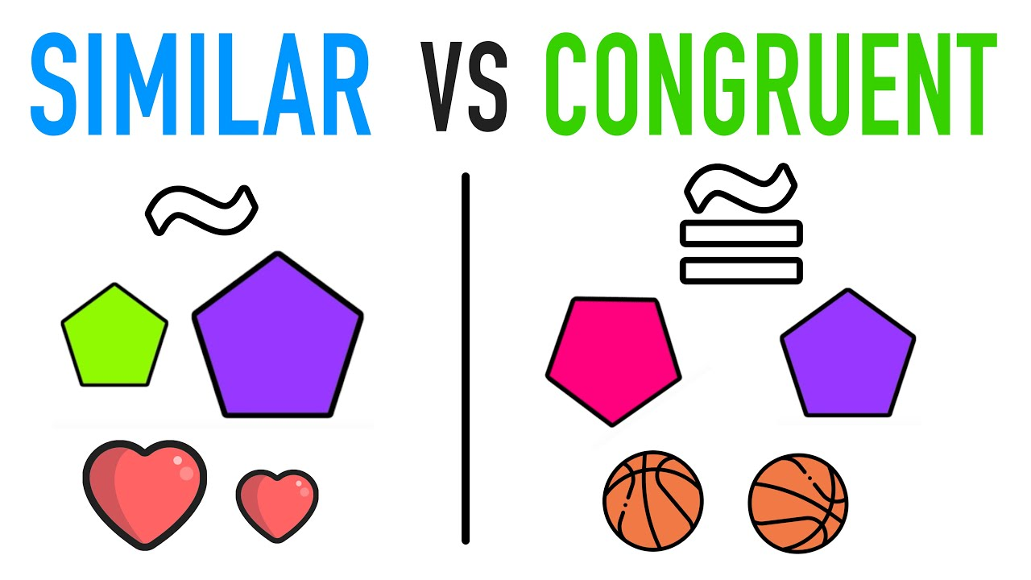
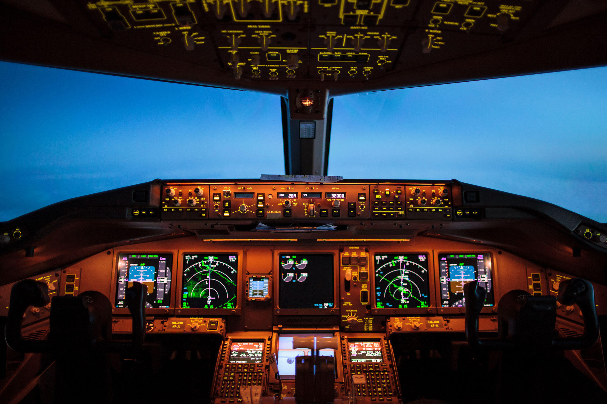
Teamwork
Identical drawing
3 truths/ 1 lie

Slide 2
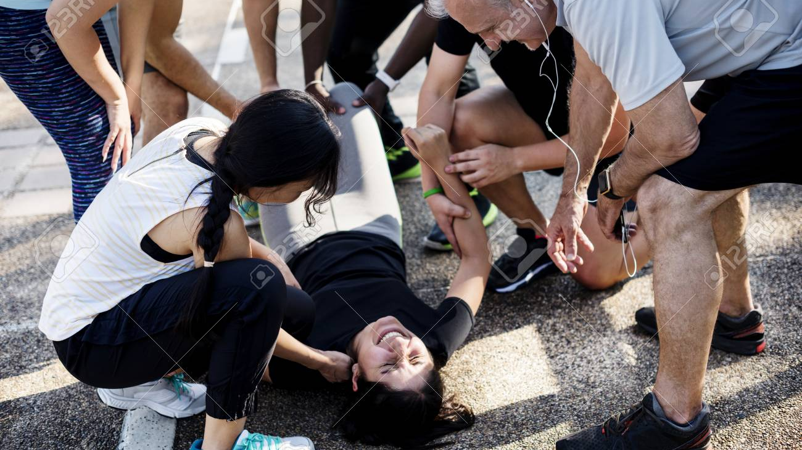
Center Stage 1

Slide 3
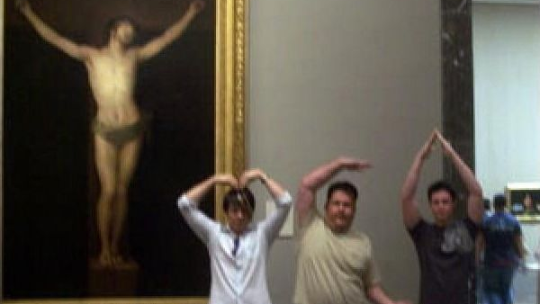
Center Stage 2

Slide 4
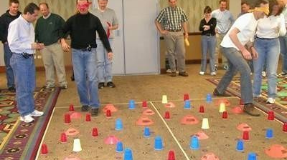
Center Stage 3

Slide 5
Center Stage 5
Plane crash, salvage 12 items from what you can see around you

Slide 6


Slide 7

Center Stage 4

