Slide 1
Review
PET M1
Steps
Match the definition with the vocabulary word learned in the previous lesson.
I breathed air back into my _____ after escaping the smoke.
I pushed my ______ through the airport.
The _____ hotel is five star.
I let my tired body drop into the ___ chair after the long day.
It was a spot of ___ that I caught the train this morning.
I appreciate the ____ flowers that you gave me.
The ____ drove down the road carrying its shipment of fruit.
The ___ thunder startled the sleeping children.
You have to always ____ when you cross the road.
The ____ of the treasure is a secret.
Outcome
This helps students use the new words that they learnt in the last class. Learn some new words in the sentences provided.
Long, look, lose, lorry, lose, loss, lost, loud, lounge, love lovely, low, lower, luck, luggage, lump, lunch, lunchtime, lung, luxury, location
© Christopher Bauman _ www.chrisbauman.com.au

Slide 2
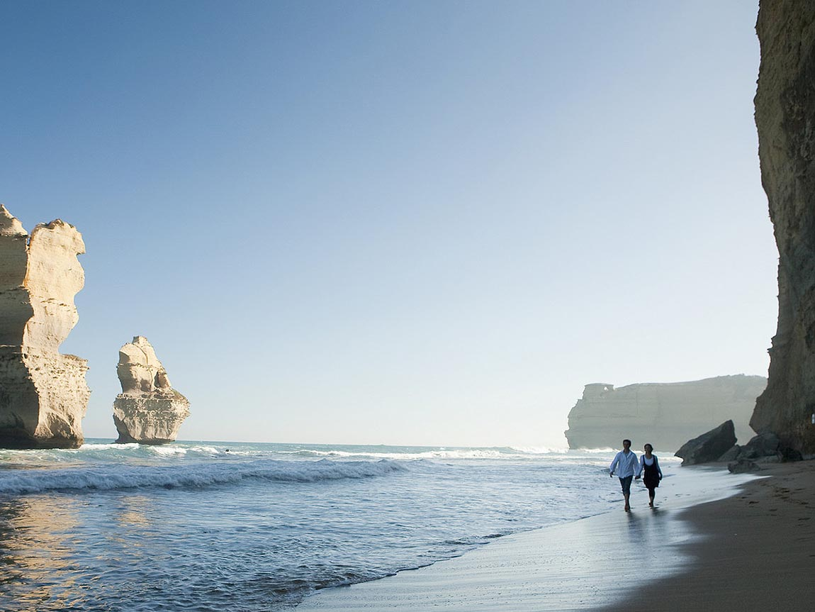
Steps
Discuss word meanings
Make sentences
Source visitmelbourbe.com (2016) retrieved from http://www.visitmelbourne.com/Regions/Great-Ocean-Road/Things-to-do/Nature-and-wildlife/Beaches-and-coastlines/12-Apostles
machine, mad, madam, magazine, magic, magnificent, mail, majority, make, makeup, main, manage, manner, manners, many, map, mark, market, marriage
Outcome
This helps students learn new words, and construct basic sentences to ensure understanding.
Wordbank
Source – Cambridge PET word List http://www.cambridgeenglish.org/
© Christopher Bauman _ www.chrisbauman.com.au

Slide 3
Fill in the blanks
Steps
Use the new words to fill in the blanks.
machine, mad, madam, magazine, magic, magnificent, mail, majority, make, makeup, main, manage, manner, manners, many, map, mark, market, marriage
Hint
The ____ spot, provided the perfect ____ between the weather and environment for our ____ photos. The ____ view is something that I will always remember. The ___ of people who visit Melbourne, go to see the 12 apostles and ____ of them ___ postcards of their trip back home. Before my trip, I had only seen pictures in ____ , but the experience of being there is something completely different. PS – don’t forget to pack a ____ in case you get lost find this wonderful place.
Outcome
This helps students to have a stronger understanding by seeing the words in the context of a sentence
© Christopher Bauman _ www.chrisbauman.com.au

Slide 4
Combine
Steps
Use the pieces of the sentence to create one strong sentence.
There was an artist
The artist was for makeup
The artist was magnificent
She managed
The management was time
The management was well
She prepared the models
The preparation was for a photoshoot
The photoshoot was for a magazine
Hint
Use – as
Outcome
This helps students learn new words, and construct basic sentences to ensure understanding.
© Christopher Bauman _ www.chrisbauman.com.au

Slide 5
Use the Pattern
Steps
Use the sentence pattern to make your own sentence
The magnificent makeup artist managed her time well as she prepared the models for a magazine photoshoot.
____________________________________________________________________________________________________________________________________________________
Hint
Outcome
By making your own sentence, it helps you to remember the pattern and use it again later.
© Christopher Bauman _ www.chrisbauman.com.au

Slide 6
Make Questions
Steps
Use the answer to the previous exercise to make questions
The magnificent makeup artist managed her time well as she prepared the models for a magazine photoshoot.
demonstrate
Who
Discuss
Believe
Assume
Hint
Outcome
Making strong questions enables students to carry out better conversations
© Christopher Bauman _ www.chrisbauman.com.au

Slide 7
Extra exercise
Steps
Use the pieces of the sentence to create one strong sentence.
There was a scientist
The scientist was mad
The scientist created
They the creation was a machine
The machine was magnificent
There was a purpose
The purpose was to sort mail
The sorting was without help
The help was from people
The people were postal workers
Hint
Use – with
Outcome
This helps students learn new words, and construct basic sentences to ensure understanding.
© Christopher Bauman _ www.chrisbauman.com.au

