Slide 1
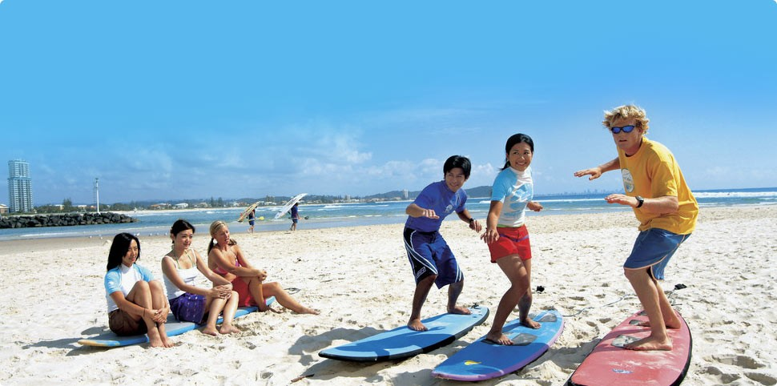
PET A1
Steps
Discuss word meanings
Make sentences
Source – CheapHolidayAustralia (2016) retrieved from http://www.cheapholidayaccommodation.com/
ability, able, about, above, abroad, absent, accept, access, accident, about, accommodation, accommodation
Outcome
This helps students learn new words, and construct basic sentences to ensure understanding.
Wordbank
Source – Cambridge PET word List http://www.cambridgeenglish.org/
© Christopher Bauman _ www.chrisbauman.com.au

Slide 2
Fill in the blanks
Steps
Use the new words to fill in the blanks.
ability, able, about, above, abroad, absent, accept, access, accident, about, accommodation, accommodation
Hint
While Jessie’s ____________ was reasonable, she couldn’t _____ the internet without paying additional fees. However, it was no ____ that she stayed here, as it is _____ the tourist area and allows her to easily walk ______ Surfer’s Paradise. She is ____ to buy lots of food and experience the wonderful atmosphere of Christmas. She doesn’t like being ______ from her company, but doesn’t thing too much about it during her holiday.
Outcome
This helps students to have a stronger understanding by seeing the words in the context of a sentence
© Christopher Bauman _ www.chrisbauman.com.au

Slide 3
Combine
Steps
Use the pieces of the sentence to create one strong sentence.
An accommodation was made
The accommodation was for the boy
The boy has a disability
The accommodation was to access
The access was from home
The access was for his classes
The boy had an accident
The accident was in a car
Hint
Use - after
Outcome
This helps students learn new words, and construct basic sentences to ensure understanding.
© Christopher Bauman _ www.chrisbauman.com.au

Slide 4
Use the Pattern
Steps
Use the sentence pattern to make your own sentence
An accommodation was made for the disabled boy to access his classes from home after his accident.
____________________________________________________________________________________________________________________________________________________
Hint
Outcome
By making your own sentence, it helps you to remember the pattern and use it again later.
© Christopher Bauman _ www.chrisbauman.com.au

Slide 5
Make Questions
Steps
Use the answer to the previous exercise to make questions
An accommodation was made for the disabled boy to access his classes from home after his accident.
Who
Why
Do you think
How
Predict
Hint
Outcome
Making strong questions enables students to carry out better conversations
© Christopher Bauman _ www.chrisbauman.com.au

Slide 6
Extra exercise
Steps
Use the pieces of the sentence to create one strong sentence.
The girl was traveling
The traveling was abroad
The girl is intelligent
The girl is young
The traveling was with her family
The traveling was to Australia
She was absent
The absence was from school
Hint
Use – Start with Traveling
Outcome
This helps students learn new words, and construct basic sentences to ensure understanding.
© Christopher Bauman _ www.chrisbauman.com.au

